Slide 1

Chess Playing Robot
Proposed by: Saad Bin Tariq (18S-BSCS-03)
Supervised by: Dr. Altaf Hussain
Dr. A. Q. Khan Institute of Computer Sciences & Information Technology, KICSIT
University of Engineering & Technology, Taxila

Slide 2
Outline
Literature Review
Introduction
Problem Statement
Problem Solution
Requirement Analysis
Analysis and Design
Implementation
CNN Models

Slide 3
Introduction
Chess is a board game for two players.
It is played in a square board, made of 64 smaller squares, with eight squares on each side.
Each player starts with sixteen pieces: eight pawns, two knights, two bishops, two rooks, one queen and one king.
The goal of the game is for each player to try and checkmate the king of the opponent.
Checkmate is a threat ('check') to the opposing king which no move can stop. It ends the game.

Slide 4
Literature Review
In previous years, a large number of chess playing machines were planned or constructed.
The first chess program was developed by Alan Turing in 1950 as an example of what a computer can do.
The two most common mechanism for moving pieces is either a robotic arm that lifts the pieces or an X-Y controlled magnetic slider underneath the board.

Slide 5
Literature Review
Currently chess programs are accessible to any regular consumer.
There are many chess engines that can be downloaded for free from the internet e.g. Stock fish, Komodo Chess, Deep Blue etc.
These engines can run on a personal computer and surpass even world champion.

Slide 6
Literature Review
Compared to these approaches, our proposed Chess Playing Robot differs in the aspect of simplicity and feasibility.
It is a low cost and compact chess playing robot that shows reliable and consistent performance.
Mechanical simplicity makes it practical in case of personal use for educational and recreational purposes.

Slide 7
Literature Review
After studying some research papers we came to with an idea to the problem discussed above. The research paper we studied, solved the problem by classifying the chess pieces into three classes (white pieces, black pieces, empty squares).
The idea we came up with is to classify all the chess pieces into different classes i.e. 13 classes (BB, BK, BN, BP, BQ, BR, ES, WB, WK, WN, WP, WQ, WR).

Slide 8
Problem Statement
Design and develop an intelligent chess playing robot able to compete with a human player based on a synthetic dataset while using an existing chess engine.

Slide 9
Solution Methodology
Build an intelligent robotic arm capable to play Chess on a real chessboard comprised of.
Robotic arm for chess movement.
Camera for perceiving opponent chess move.
Chess engine as a mind of this intelligent robot arm.

Slide 10
Analysis and Design

Slide 11
Behavioral Diagrams
Use Case
Activity

Slide 12
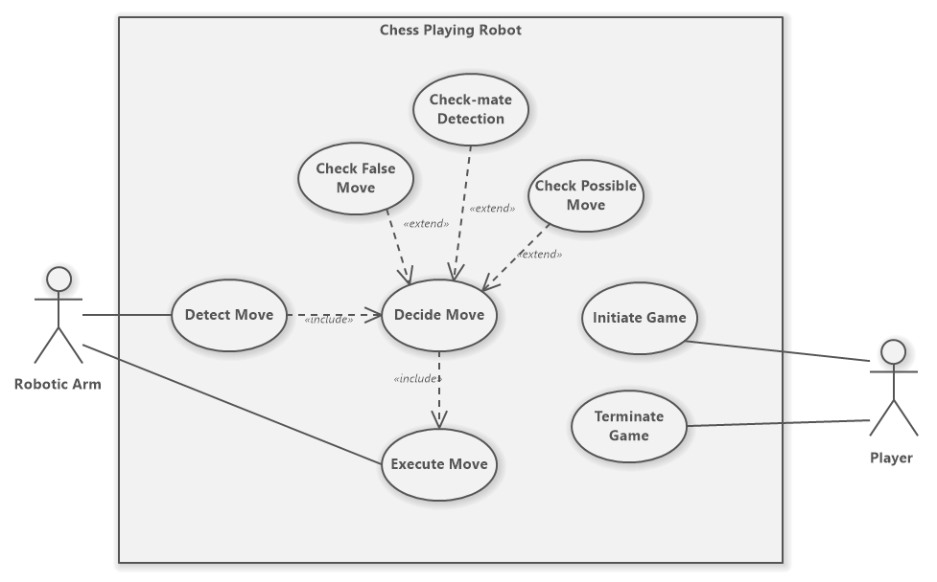
Use Case Diagram

Slide 13
Descriptive Use Cases

Slide 14
Initiate Game
Use Case | Initiate Game
Primary Actors | User
Objective | The user runs the program.
Pre-Condition | The Camera module should be working properly.
 | The Models have been Loaded.
 | The Arduino is connected to the laptop.
Post-Condition | The program is running successfully.
Main Scenarios
Success Scenarios
User Action | System Response
1.The user runs the program | 2.The Game has started successfully
Failure Scenarios
User Action | System Response
1.Arduino is not connected to but is not working. | 2.The Arduino Port is not correct.
3.The Camera is working but not connected. | 4.The IP Address of the Camera is not Correct.

Slide 15
Detect Move
Use Case | Detect Move
Primary Actors | Robot
Objective | The Camera captures the image of the chess board which is fed to a CNN Model that decides the Pieces are at what location and returns an 8x8 Array of the Chessboard.
Pre-Condition | Player has made some move on the board
Post-Condition | Robot has successfully detected the move
Main Scenarios
Success Scenarios
User Action | System Response
1.The Player makes a move by moving a piece from one square to another | 2.The robot detects that the player has made a move.
 | 3.The Robot extracts the board from the overhead camera feed and identifies which move has been made by the player
 | 4.The Robot updates the current game state and displays it to the user
Failure Scenarios
User Action | System Response
1.The Player makes an invalid move | 2.The Robot detects the invalid move and reverts the changes made by the user
3.The Robot incorrectly identifies a valid move made by the player | 4.The player restores the game state to the point before they made their move and the Robot detects the move again

Slide 16
Decide Move
Use Case | Decide Move
Primary Actors | Robot
Objective | The user move is validated by the Chess Engine.
 | Chess Engine decides whether the game is over or not.
 | The Chess Engine decides the counter move for the Robotic Arm.
Pre-Condition | User makes a move
Post-Condition | The counter move is generated successfully.
Main Scenarios
Success Scenarios
User Action | System Response
1.User makes changes to the board by making a move | 2.The counter move is generated successfully
Failure Scenarios
User Action | System Response
3.The user move was incorrectly identified the CNN Model | 4.The Chess Engine was not able to decide the user move

Slide 17
Execute Move
Use Case | Execute Move
Primary Actors | Robot
Objective | The Chess Engine generates a counter move in response to the user move which is physically executed by the Robotic Arm on the Chess Board
Pre-Condition | Robot has successfully generated the counter move
Post-Condition | Robot has successfully executed the move
Main Scenarios
Success Scenarios
User Action | System Response
1.The user move was correctly identified the CNN Model | 2.The Robot successfully executed the move generated by the chess engine on the desired square
Failure Scenarios
User Action | System Response
1.The user move was incorrectly identified the CNN Model | 2.The Chess Engine was not able to generate the counter move in response

Slide 18
Terminate Game
Use Case | Terminate Game
Primary Actors | User
Objective | The user ends the program.
Pre-Condition | The program should be running.
Post-Condition | The program is terminated successfully.
Main Scenarios
Success Scenarios
User Action | System Response
1.The user ends the program | 2.The program has ended successfully
Failure Scenarios
User Action | System Response
3.The user ends the program | 4.The kernel is running a cell so cannot terminate the Program

Slide 19
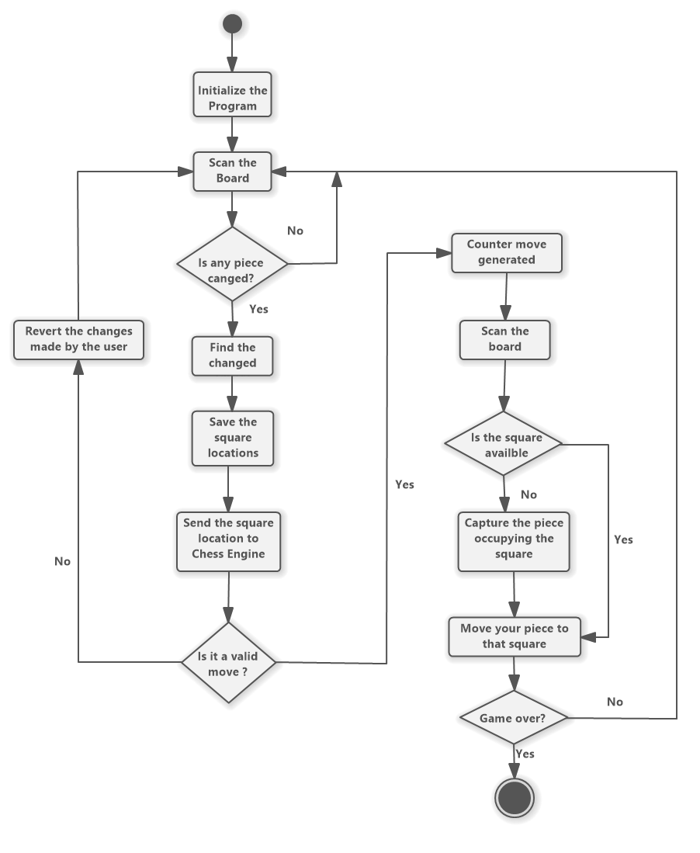
Activity Diagram

Slide 20
Interaction Diagrams
Sequence Diagram

Slide 21
Sequence Diagram

Slide 22
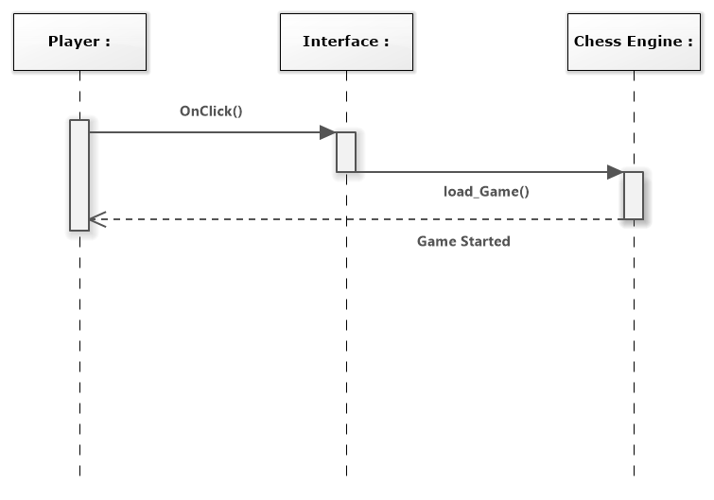
Initiate Game

Slide 23
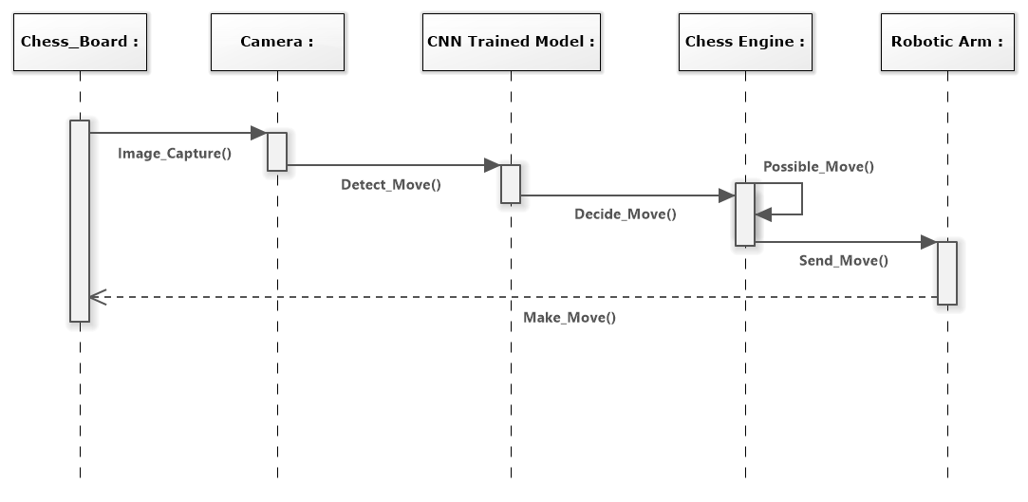
Move Detection and Execution

Slide 24
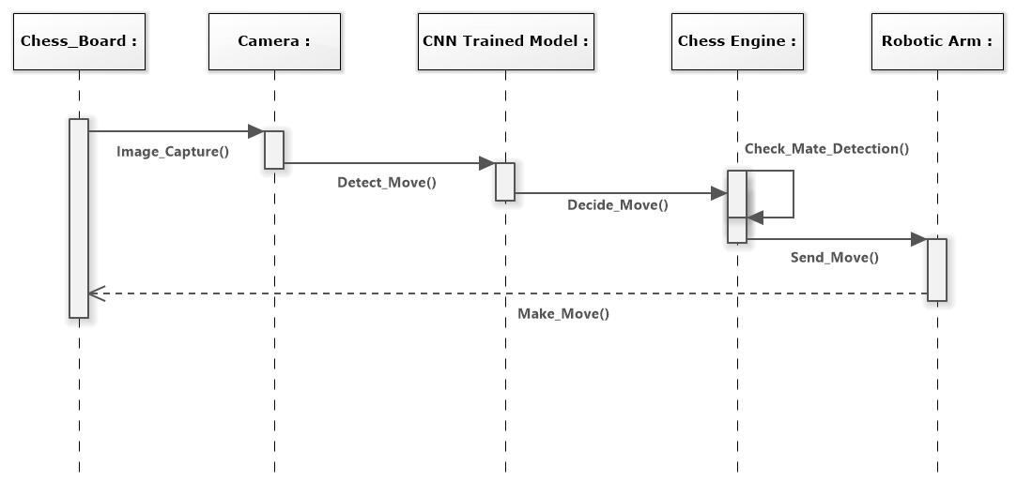
Check Mate Detection

Slide 25
Circuit Diagram

Slide 26
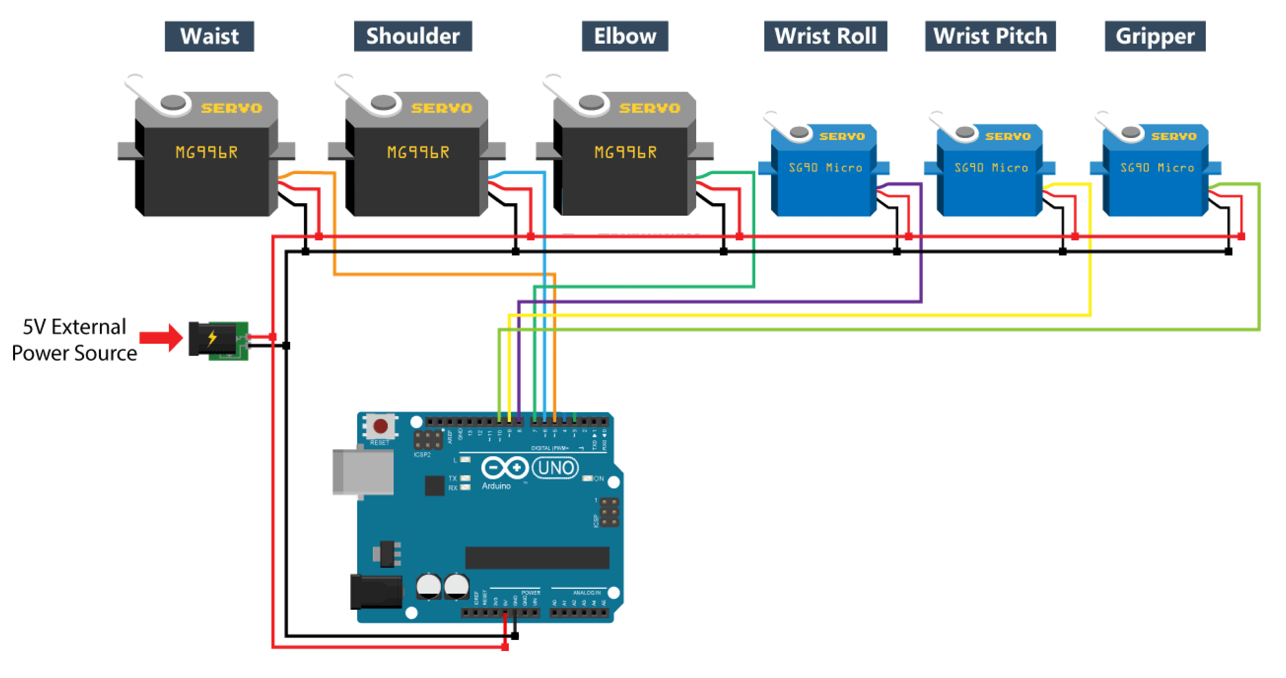
Circuit Diagram

Slide 27
Implementation

Slide 28
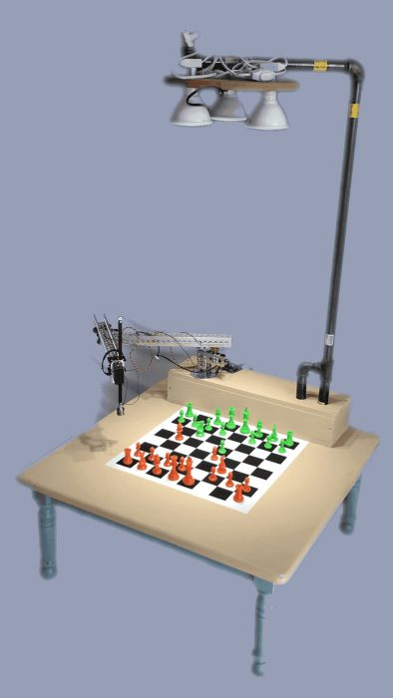
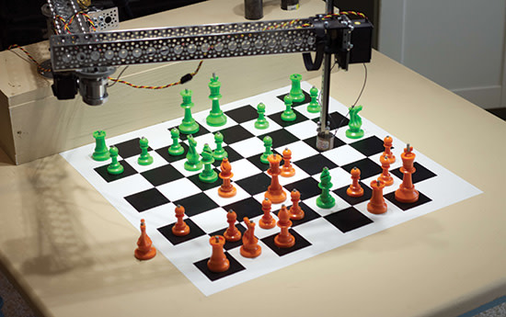
Proposed Chess Playing Robot

Slide 29
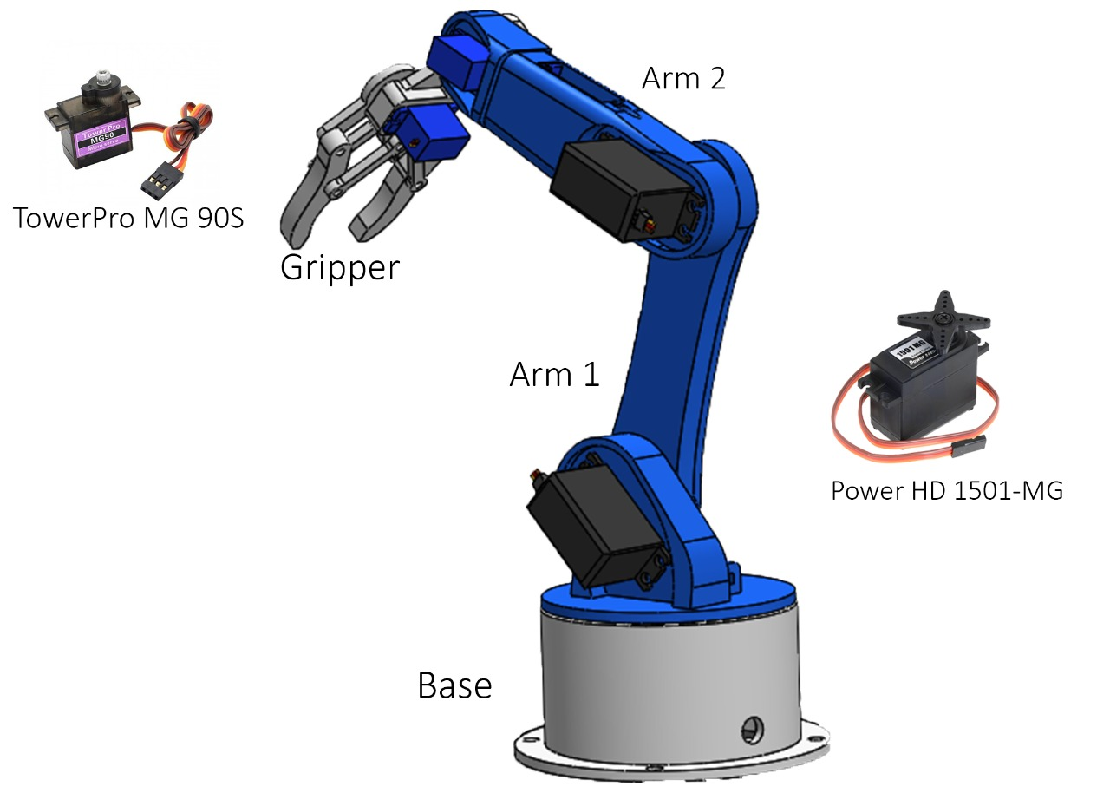
Proposed Chess Playing Robot

Slide 30
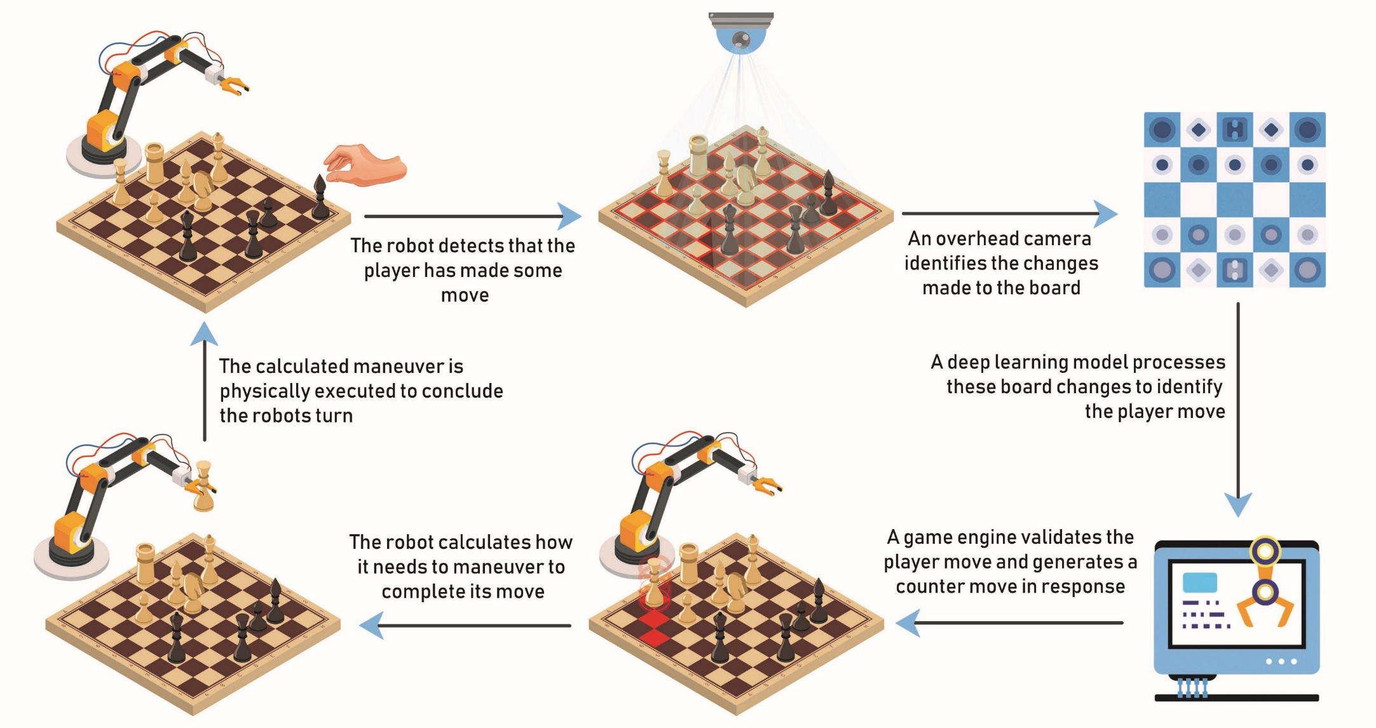
Working Architecture

Slide 31
Tools and Technologies
For Software
Arduino IDE for Servo Motors of the ARM
Python with OpenCV, numpy, matplotlib, tensorflow, chess
Chess Engine (Stock-fish)
Solidworks for Windows
Jupyter Notebook / Jupyter Lab
MATLAB

Slide 32
Tools and Technologies
For Hardware
Robotic ARM
Arduino UNO R3
TowerPro SG90 Servo Motor x3
TowerPro MG996-R Servo Motor x1
Power HD 1501MG Servo Motor x2
Camera Module
Voltage Regulator LM2596
Breadboard

Slide 33
Chess Engine
A chess engine is a computer program that analyzes chess positions and returns what it calculates to be the best move options.
If computers were chess players, engines would be their brains.
Chess.com, for instance, allows users to play against computer personalities using the Komodo engine and uses Stockfish in the Analysis Board.

Slide 34
Chess Engine
Most Popular Chess Engines:
Stockfish
Alpha Zero
Leela Chess Zero
Komodo Chess
Deep Blue
Shredder Chess
Fritz

Slide 35
Chess Engine
Stockfish:
Stockfish is currently the strongest chess engine available to the public.
As an open-source engine, an entire community of people is helping to develop and improve it.
Like many others, Stockfish has included neural networks in its code to make even better evaluations of chess positions.
Stockfish is available to the public on all major platforms like Windows, Mac OS X, Linux, iOS, and Android.

Slide 36
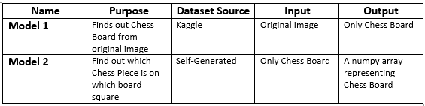
CNN Models
The Chess playing robot uses two Convolution Neural Network (CNN)models:

Slide 37

CNN Models - Model 1
Purpose:
This model finds the chess board from the original picture based on the dataset of the possible corners.
Accuracy:

Slide 38
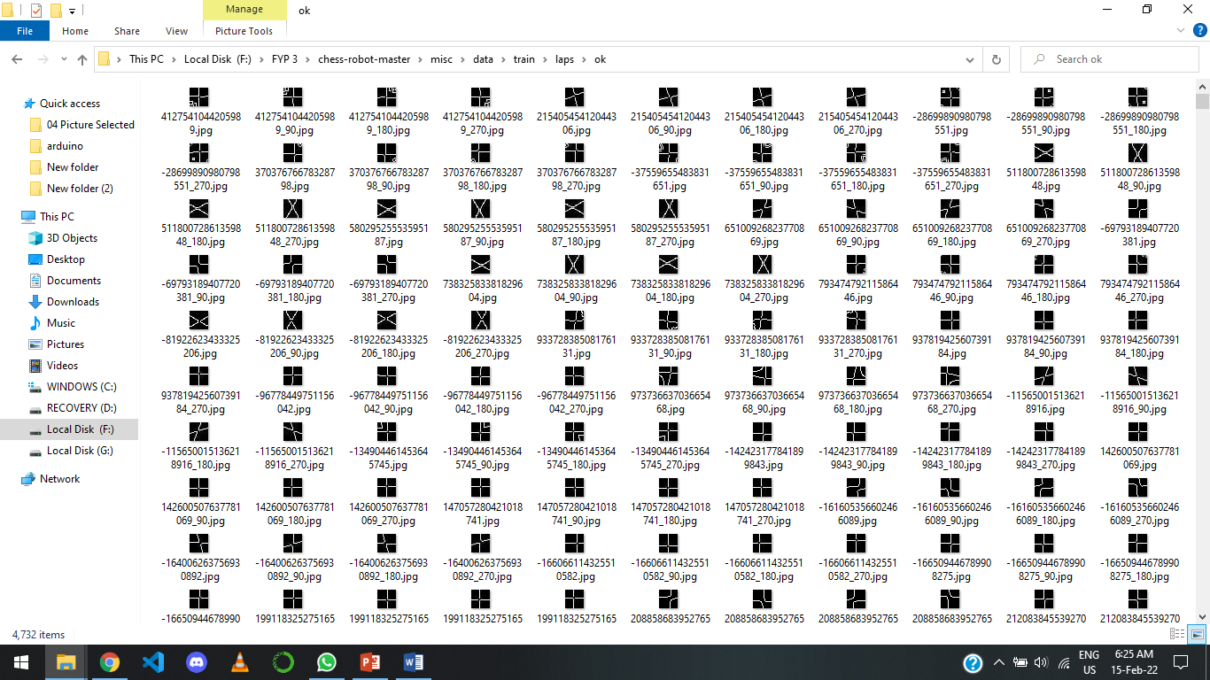
CNN Models - Model 1
Dataset:

Slide 39
CNN Models - Model 1
Input
Output 1
Output 2
Output 3

Slide 40
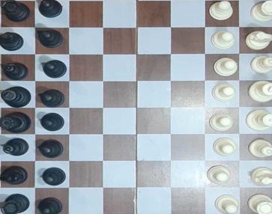
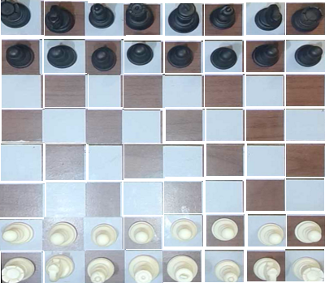
CNN Models - Preprocessing
Purpose:
The last output of 1st Model needs to be preprocessed before sending it to the next Model. The image is divided/cut into 64 Equal Images of size 150 x 150.

Slide 41
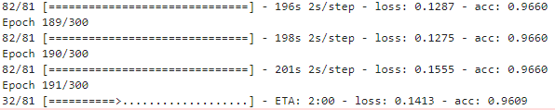
CNN Models - Model 2
Purpose:
The output of the 1st model is the input of the 2nd model after Preprocessing. The Preprocessing creates 64 images of 150 x 150 size. The preprocessed 64 images are then classified into one of the 13 classes, finding out which square belongs to which class and then creates the 8x8 array which represents the current status of this chess board.
Accuracy:

Slide 42
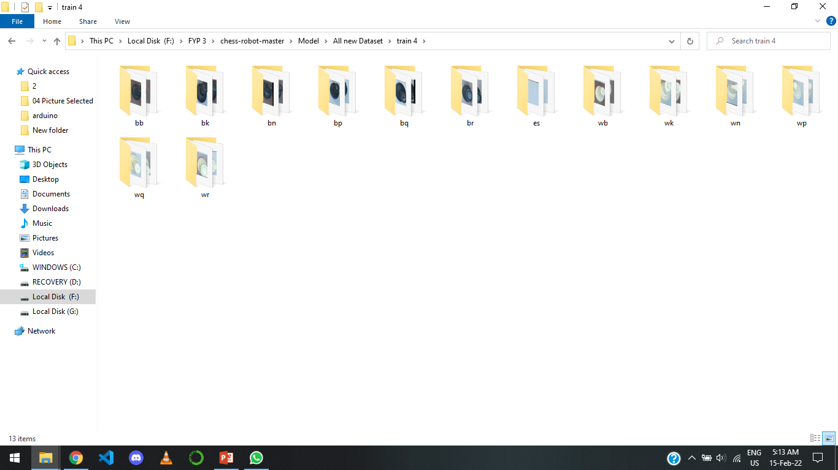
CNN Models - Model 2
Dataset:

Slide 43
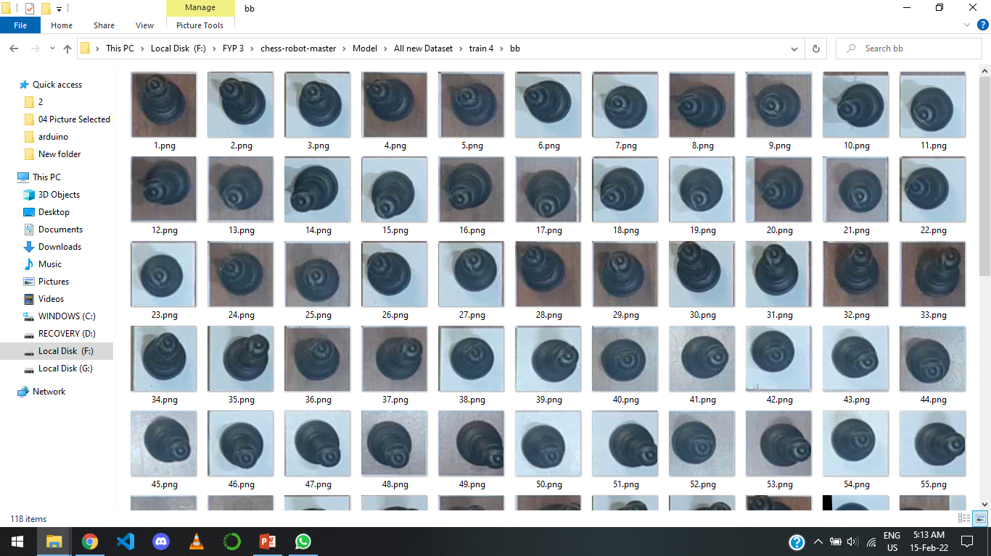
CNN Models - Model 2
Dataset:

Slide 44
CNN Models - Model 2
Output
Input

Slide 45
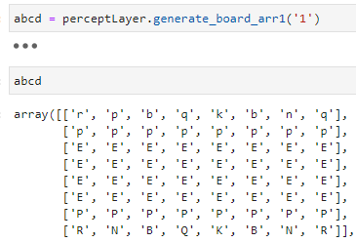
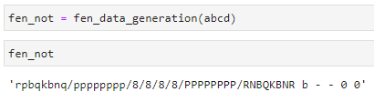
FEN Notation Creation
The Array representing the Chess Board is converted into FEN Notation so it can be sent as an input to the Chess Engine which will generate the counter move of the Robot.

Slide 46
FEN Notation
FEN is the abbreviation of Forsyth-Edwards Notation, and it is the standard notation to describe positions of a chess game.
FEN differs from the Portable Game Notation (PGN) because it denotes only a single position instead of the moves that lead to it.

Slide 47
FEN Notation Importance
FEN is important because it makes it easy to translate any chess position into a single line of text.
It facilitates the process of recreating positions using computers and allows players to share them and restart games from any point they desire.

Slide 48
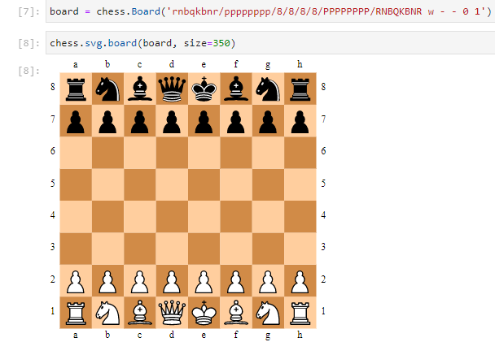
FEN Notation

Slide 49
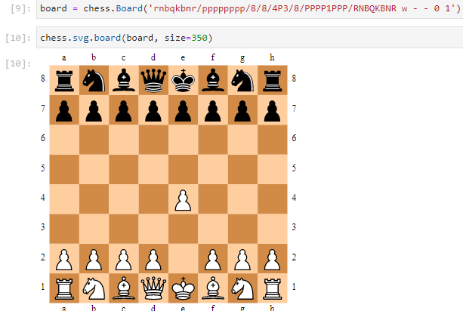
FEN Notation

Slide 50
Conclusion
In our FYP we have creates a chess playing robot.
Shockfish is used as the chess engine.
We have created our own data set for individual chess piece recognition for the purpose of recognizing the whole chess board

Slide 51
Questions!!!

